Slide 1
Water reuse in Europe - needs for and
barriers to innovation
Zakhar Maletskyi
NMBU
2nd Project Meeting
This project has been funded with support from the European Commission. This publication reflects the views only of the author, and the Commission cannot be held responsible for any use which may be made of the information contained therein.

Slide 2
Content
Global challenges
Needs in Europe
Challenges-Opportunities
Barriers for innovation

Slide 3
Water Industry
Technology
Management

Slide 4
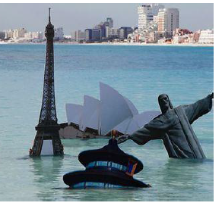
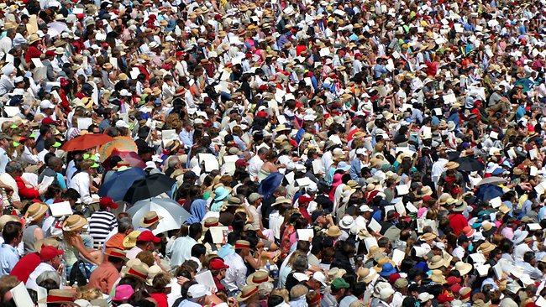
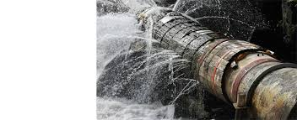
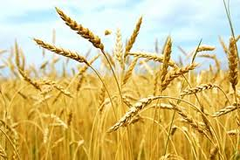
Global change pressures will
make things more difficult in future

Slide 6
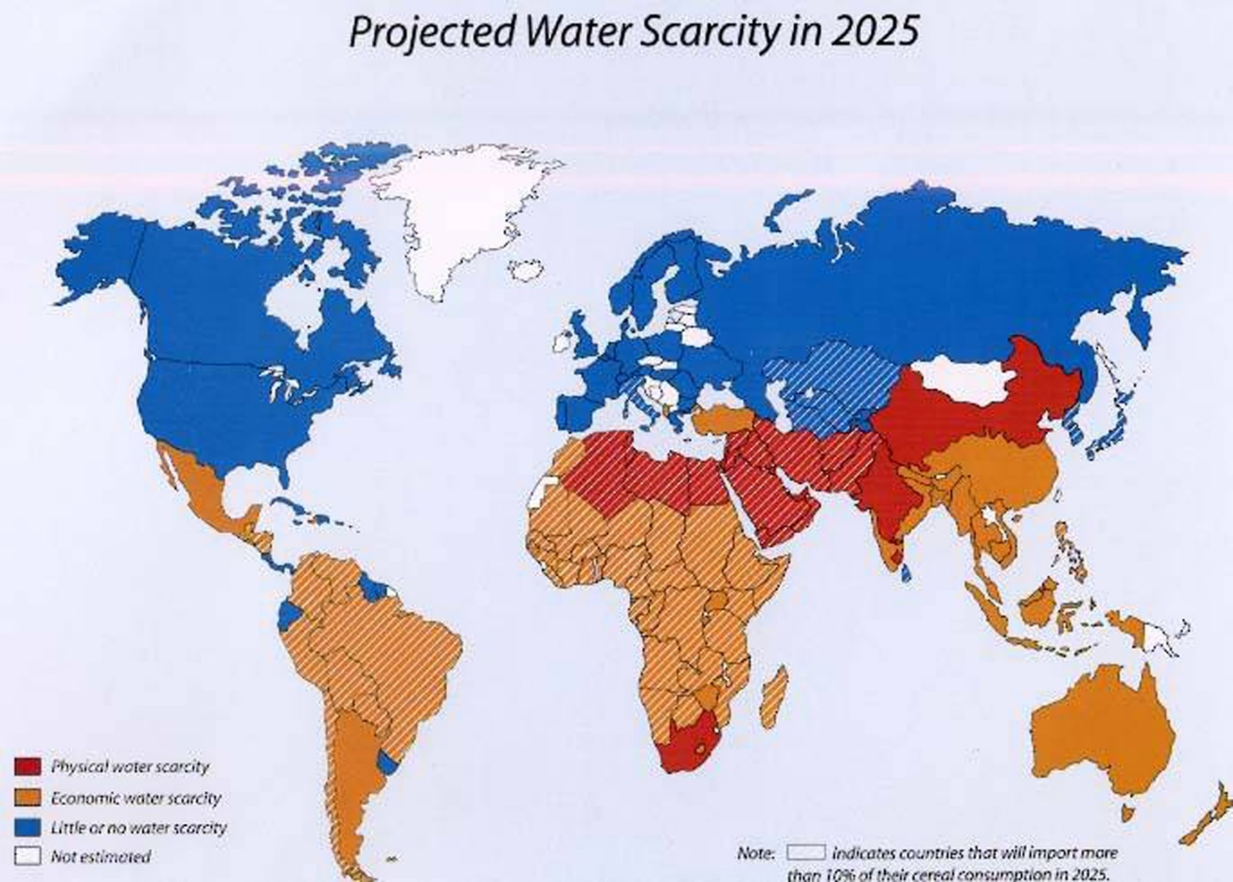
Water Availability vs. Consumption
Sustainable?

Slide 7
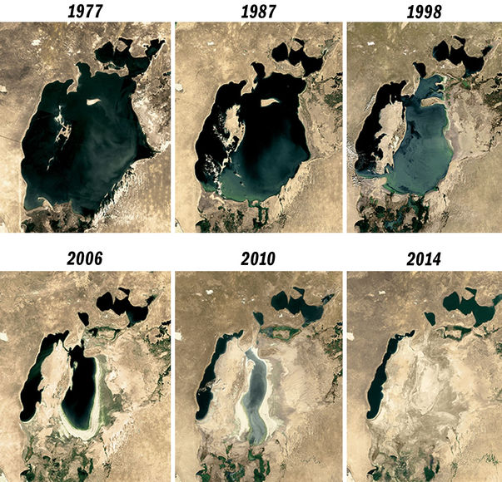

Slide 8
?

Slide 9
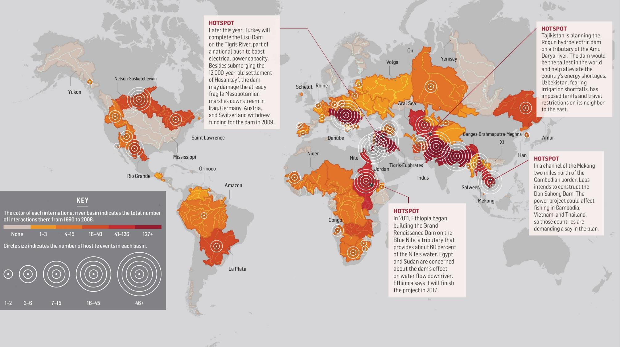

Slide 11
Water & Global Risks

Slide 12
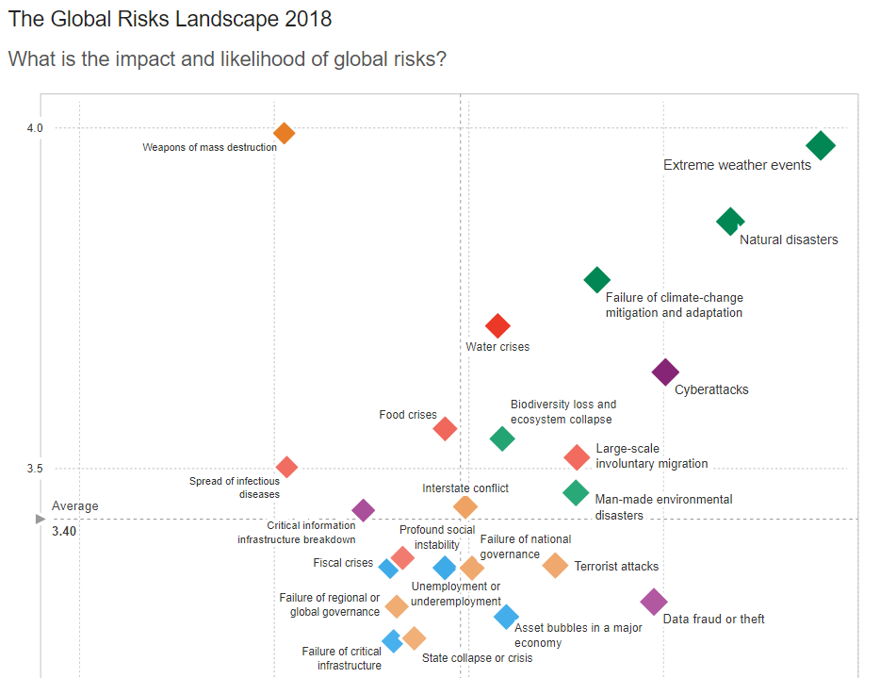
Impact
Likelihood

Slide 13
According to the World Resources Institute
We're Changing the Climate, Making Dry Areas Drier and Precipitation More Variable and Extreme
More People + More Money = More Water Demand
Groundwater Is Being Depleted (54% in India)
Water Is Wasted
Water Infrastructure Is in a Dismal State of Disrepair
Natural Infrastructure Is Being Ignored
The Price Is Wrong

Slide 14
Needs in Europe

Slide 15
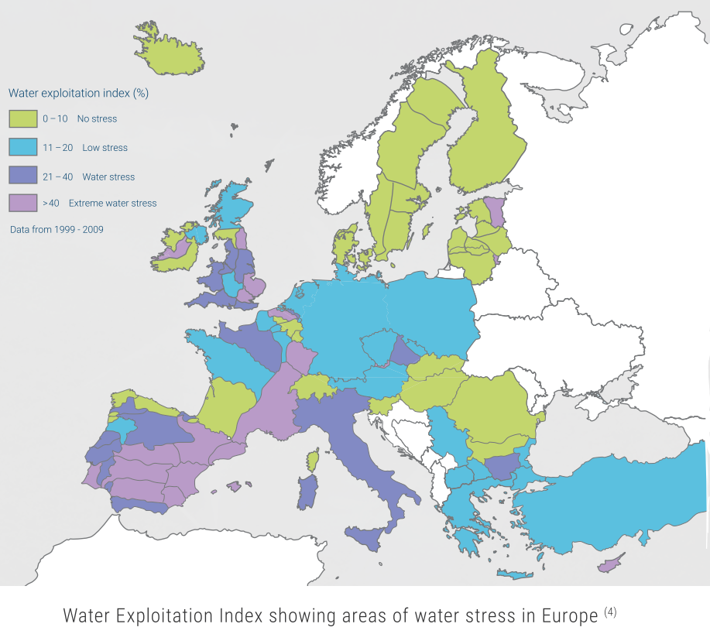

Slide 16
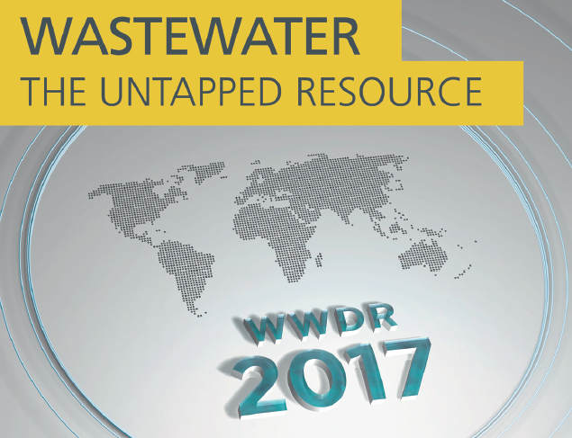

Slide 17
Pierre Henry, DG Environment, Unit "Eco-innovation and Circular Economy"

Slide 18
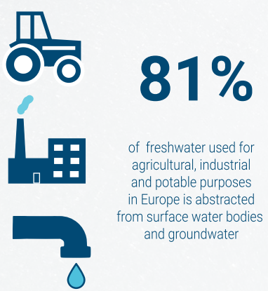
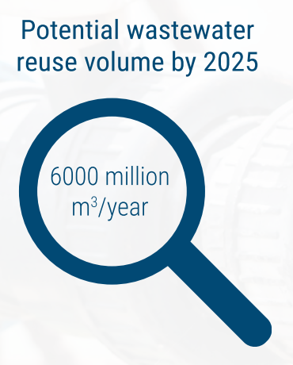
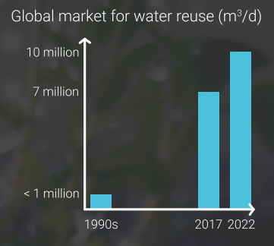
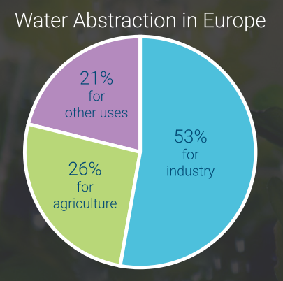

Slide 19
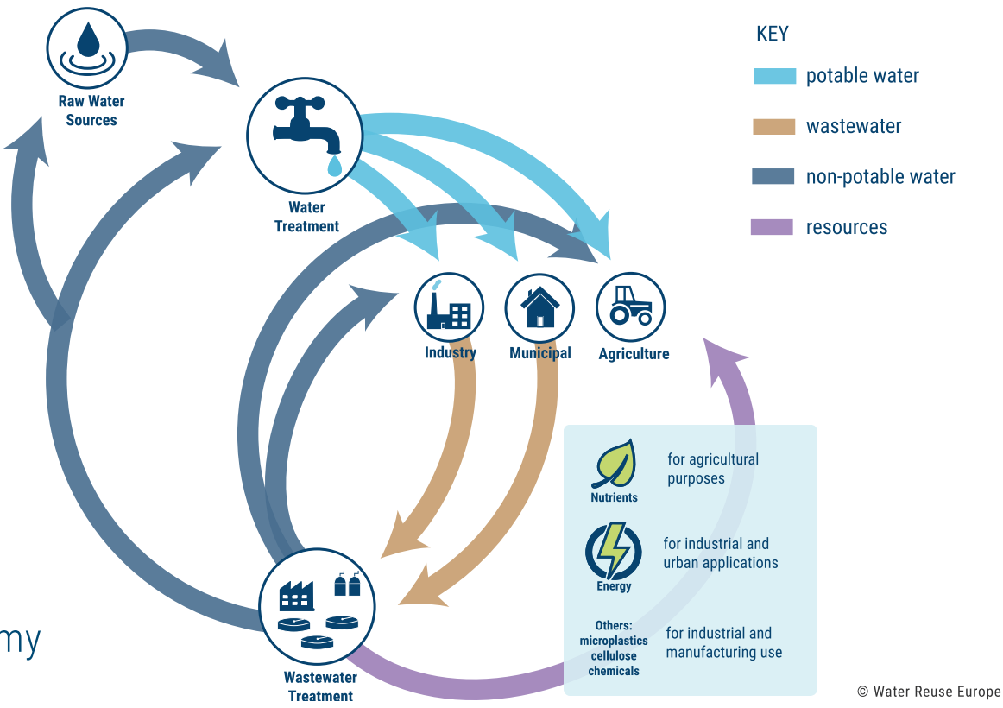

Slide 20
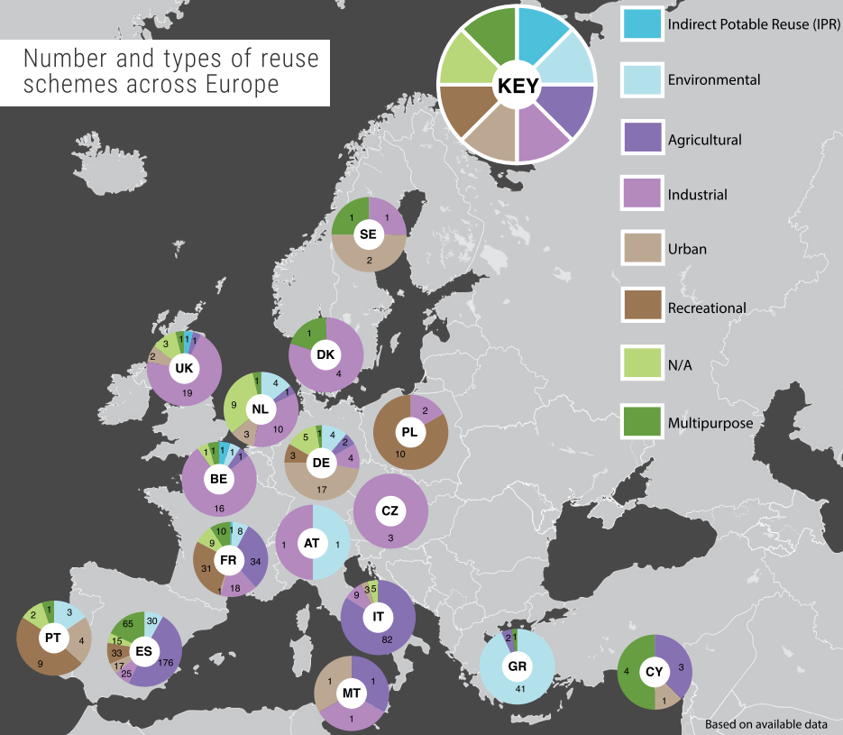
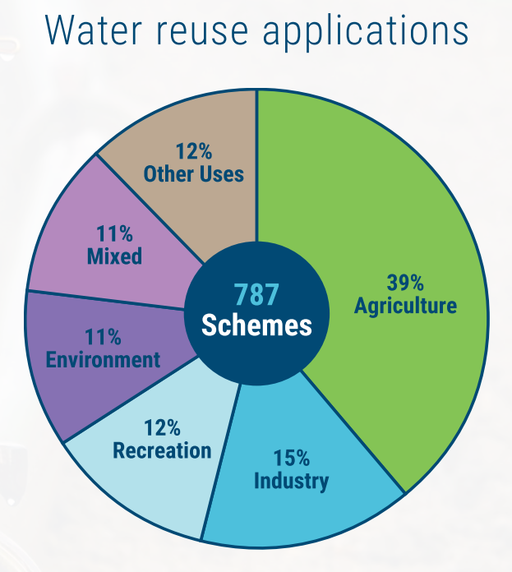

Slide 21
Enabling technologies

Slide 22
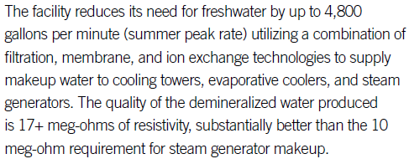
Successful stories

Slide 23
Successful stories

Slide 24
Successful stories

Slide 25
Successful stories

Slide 26
Challenges-Opportunities

Slide 27
Recent EU legislation related to water reuse
When adopted | Document | Summary
October 2018 | Changes to the Drinking Water Directive (98/82/EC) | No specific mentioning of water reuse, but emphasis on helping Europe in transition to circular economy
January 2018 | EU minimum quality requirements for water reuse in agricultural irrigation and aquifer recharge - Science for Policy Report [8] | Proposes minimum quality requirements for the reuse of water for agricultural purposes and aquifer recharge for the protection of the environment and human health. To be used as a basis for defining future EU legislation on the reuse of water in agriculture
2016 | Guidelines for Integrating Water Reuse into Water Planning and Management in the context of the Water Framework Directive | Common strategy for the development and implementation of reuse schemes
2013 | Priority Substance Directive (2013/39/EU) | An amendment to the Water Framework Directive. Sets out a list of 45 “priority” substances for surface waters which must stay below specified levels that are safe for water bodies and human health.

Slide 28
Current challenges-opportunities in reuse
Economic models for partial or full cost recovery
Technical challenges in nutrient recovery
Energy efficiency
Case studies to assure that produced water has the appropriate quality

Slide 29
Barriers to more active water reuse in PER
Inadequate water pricing and business models
Insufficient monitoring of freshwater abstraction
Uncertainties for decision-makers
Very stringent water reuse standards in some EU Member States
Reuse not seen as a component of integrated water management approaches
Technical barriers and scientific uncertainties

Slide 30
Barriers for innovation
Fragmentation of the sector
Slow adaption
Lack of holistic vision of water management considering its whole life cycle
Absence of SME development
Social acceptance
Management and business models to develop innovations to commercialization

Slide 31
Most of challenges are not technical, but in the management plane

Slide 32
Water Industry
Technology
Management

